Slide 1
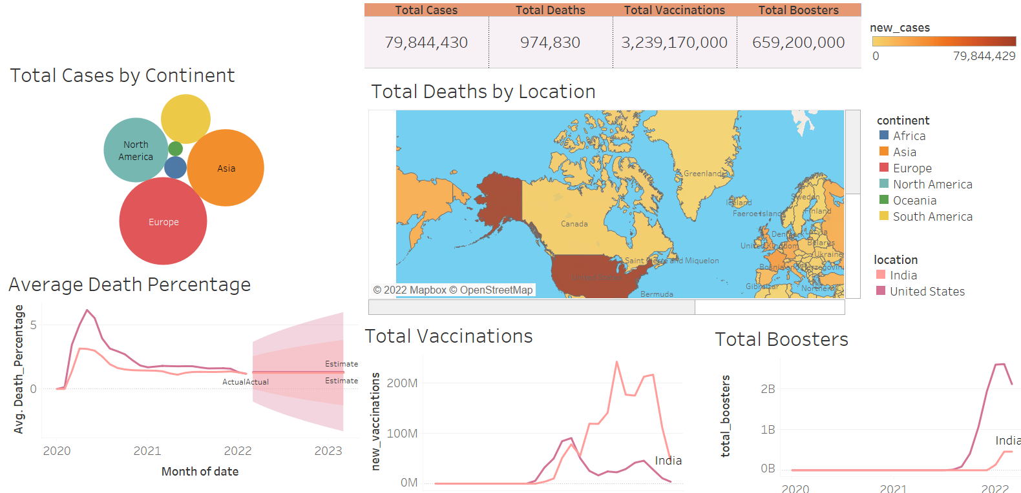
COVID DATA VISUALIZATION

